Slide 1


DESIGN ASSIGNMENT
Group - 7
Rohit Rahul Mundada – 2019A3PS0343G
Saksham Kamath – 2019A3PS0373G
Ayush Sharma – 2019A3PS0360G
Yash Gauram Bagrecha – 2019A3PS0387G
Varinda Bansal – 2019A3PS0350G
Umang Sinha – 2019A3PS0383G

Slide 2
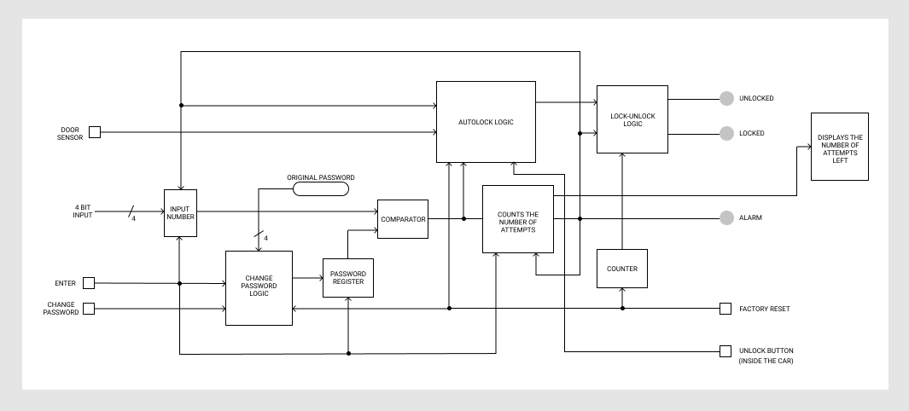
Top LEVEL BLOCK DIAGRAM :

Slide 3
One sample input/output :
Sample Password: 0101 (5-Base10)
INPUT | ALARM | LOCK
0000 | 0 | 1
0001 | 0 | 1
0010 | 0 | 1
0011 | 1 | 1
INPUT | ALARM | LOCK
0000 | 0 | 1
0101 | 0 | 0

Slide 4
Additional functionalities developed :
Factory Reset:
Once the alarm rings, the car cannot be opened again. The user can contact the car service center personnel. They can then factory reset the lock once which enables the mux and the number of attempts are also restored back to 4 and the original password id again stored into the Password register.
2. AutoLock (Additional Feature):
Once the user enters the correct password the auto-lock feature is enabled which starts counting on every clock pulse of frequency of 0.25Hz till the counter stores f(Base16-Hexadecimal) or 1111(Base2-Binary). Once the counter reaches f,this implies that a time span of 1 minute has passed and thus the feature auto-locks the car.
3. Change Password (Additional Feature):
The Change Password Pin is activated so that the user may enter the correct password and then change the password as per his convenience.The Initial Password stored in the register shown in the circuit is 5.
3. (contd) Password Changed:
After the correct password is entered the user enters the new password and presses enter so that the new password gets stored inside the register. The new password stored in the register is b(1011-base2).

Slide 5
4. First Factory Reset:
Once the alarm rings the user can contact the service centre personnel.They can then factory reset the lock once which enables the mux and causes the select line of the mux to carry a logical LOW -> ‘0’.At the same time the register carrying the comparison is reset. All the registers/counters are reset except for the register storing the password.
4. (CONTD) Second Factory Reset:
At the second factory reset the factory reset acts like a clock and loads the register with the original master password which the user will have in his/her car documents.
5. LED 7 Segment Display We have used the display to show the user the number of attempts left for him to input the correct password.The 7 segment display is reset to 4, everytime the user inputs the correct password indicating that he has 4 chances to input the correct password.The alarm rings as soon as the display indicates 0 which means the user has exhausted all of his attempts to enter the correct password.

